Slide 1
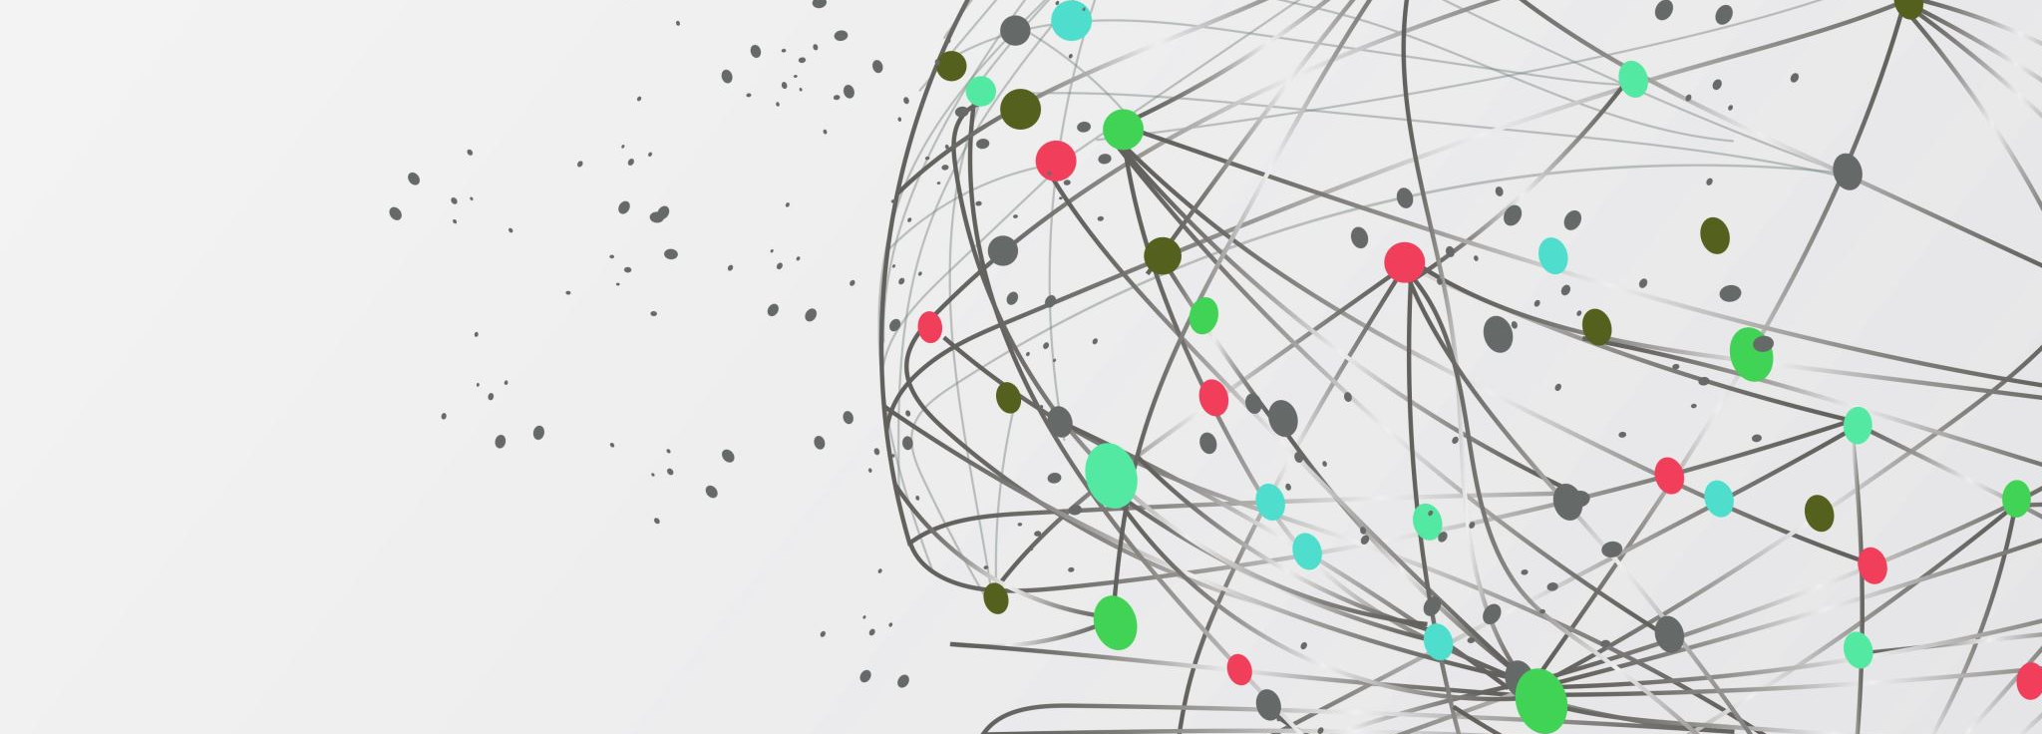
Communications Team Engagement Strategies

Slide 2
Agenda
User Engagement Highlights
Internal Marketing Campaigns
Next Steps for Engagement
Notes:
Agenda * Initial Engagement Statistics * Campaign Overview * Targeted Outreach Plans

Slide 3
User Engagement Highlights
High Internal Engagement
70% of invited employees logged in within the first two weeks
Explored at least one module
Course Completion
Average of 2.4 courses completed per user
Popular topics: Leading Hybrid Teams and Time Management Essentials
Positive Feedback
88% of users found the content useful
9 out of 10 would recommend the platform to a colleague
Notes:
The new learning platform has seen strong internal engagement since its soft launch. Within two weeks, 70% of invited employees logged in, completing an average of 2.4 courses each. Popular topics include Leading Hybrid Teams and Time Management Essentials. Feedback shows 88% found the content useful, and 9 out of 10 would recommend it. Original Content: Since the soft launch of the new learning platform, internal engagement has been strong. Within the first two weeks, over 70% of invited employees logged in and explored at least one module. On average, users completed 2.4 courses each, with the most popular topics being “Leading Hybrid Teams” and “Time Management Essentials.” Feedback collected through in-platform surveys showed that 88% of users found the content useful, and 9 out of 10 said they’d recommend the platform to a colleague.

Slide 4

Internal Marketing Campaigns
Multi-Channel Internal Campaign
Teaser emails to generate interest
Slack announcements for quick updates
Manager toolkits to aid in promotion
Intro videos highlighting platform benefits
Reinforcement through Visuals
Posters in high-traffic office areas
Digital signage to maintain visibility
Manager Participation
Key role in boosting adoption
Teams with manager involvement saw 20% higher completion rates
Notes:
The Communications team launched the 'Learn. Lead. Level Up.' campaign using emails, Slack, toolkits, and videos. Posters and digital signage reinforced the message. Manager participation led to a 20% higher completion rate. Original Content: To build awareness and drive engagement, the Communications team launched a multi-channel internal campaign titled “Learn. Lead. Level Up.” The campaign featured teaser emails, Slack announcements, manager toolkits, and short intro videos spotlighting the platform’s benefits. Posters and digital signage in high-traffic office areas helped reinforce messaging. Manager participation played a key role in boosting adoption—those teams saw 20% higher completion rates compared to the average.

Slide 5
Next Steps for Engagement
Communications will launch a second wave of targeted outreach, focusing on departments with lower usage rates. Personalized nudges and spotlight stories will help maintain momentum. A monthly “Learning Leaderboard,” FAQ hub, and video series will also be introduced. Original Content: Looking ahead, Communications will launch a second wave of targeted outreach focused on departments with lower usage rates. Personalized nudges, spotlight stories featuring early adopters, and a monthly “Learning Leaderboard” will help maintain momentum. The team is also developing an FAQ hub and a short video series to answer common questions and make the platform even easier to navigate.
Notes:
Communications will launch a second wave of targeted outreach, focusing on departments with lower usage rates. Personalized nudges and spotlight stories will help maintain momentum. A monthly “Learning Leaderboard,” FAQ hub, and video series will also be introduced. Original Content: Looking ahead, Communications will launch a second wave of targeted outreach focused on departments with lower usage rates. Personalized nudges, spotlight stories featuring early adopters, and a monthly “Learning Leaderboard” will help maintain momentum. The team is also developing an FAQ hub and a short video series to answer common questions and make the platform even easier to navigate.

